Slide 1


Vicente HERREROS JUSTEL
28/03/2025

Slide 2

Outline
Executive Summary
Introduction
Methodology
Results
Conclusion
Appendix

Slide 3
Executive Summary
Summary of methodologies
Data collection methodology:
Perform data wrangling
Perform exploratory data analysis (EDA) using visualization and SQL
Perform interactive visual analytics using Folium and Plotly Dash
Perform predictive analysis using classification models
Summary of all results
Exploratory data analysis results
Interactive analytics demo in screenshots
Predictive analysis results

Slide 4
Introduction
Project background and context
The commercial space age is here, companies are making space travel affordable for everyone. Perhaps the most successful is SpaceX. One reason SpaceX can do this is the rocket launches are relatively inexpensive. SpaceX advertises Falcon 9 rocket launches on its website with a cost of 62 million dollars; other providers cost upwards of 165 million dollars each, much of the savings is because SpaceX can reuse the first stage
Problems you want to find answers
Space Y wants to compete with SpaceX. The main questions are to determine the price of each launch and if SpaceX will reuse the first stage. This will be done training a machine learning model using public information.

Slide 5

Section 1

Slide 6
Methodology
Executive Summary
Data collection methodology:
Data Collection API to retrieve data from SpaceX API
Web Scraping from https://en.wikipedia.org/wiki/List_of_Falcon_9_and_Falcon_Heavy_launches
Perform data wrangling
Exploratory Data Analysis
Determine Training Labels
Perform exploratory data analysis (EDA) using visualization and SQL
Perform interactive visual analytics using Folium and Plotly Dash
Perform predictive analysis using classification models
How to build, tune, evaluate classification models

Slide 7
Data Collection
First data set regarding rocket launches is collected from the SpaceX API. That includes information such as payloads, launch sites, coordinates:
Take response from SpaceX API
Decode into Json and transform it into a dataframe
Filter to include only Falcon 9 launches
Deal with missing values
Second data set collected through web scraping a web site
Launch the page and extract all HTML tables
Create a dataframe from the launches table, parsing it

Slide 8
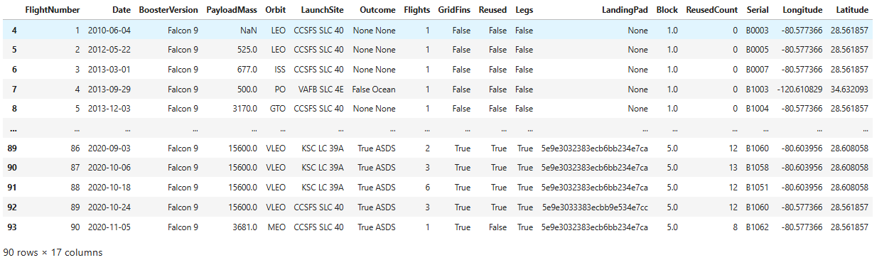
Data Collection – SpaceX API
GitHub URL of the completed SpaceX API calls notebook

Slide 9
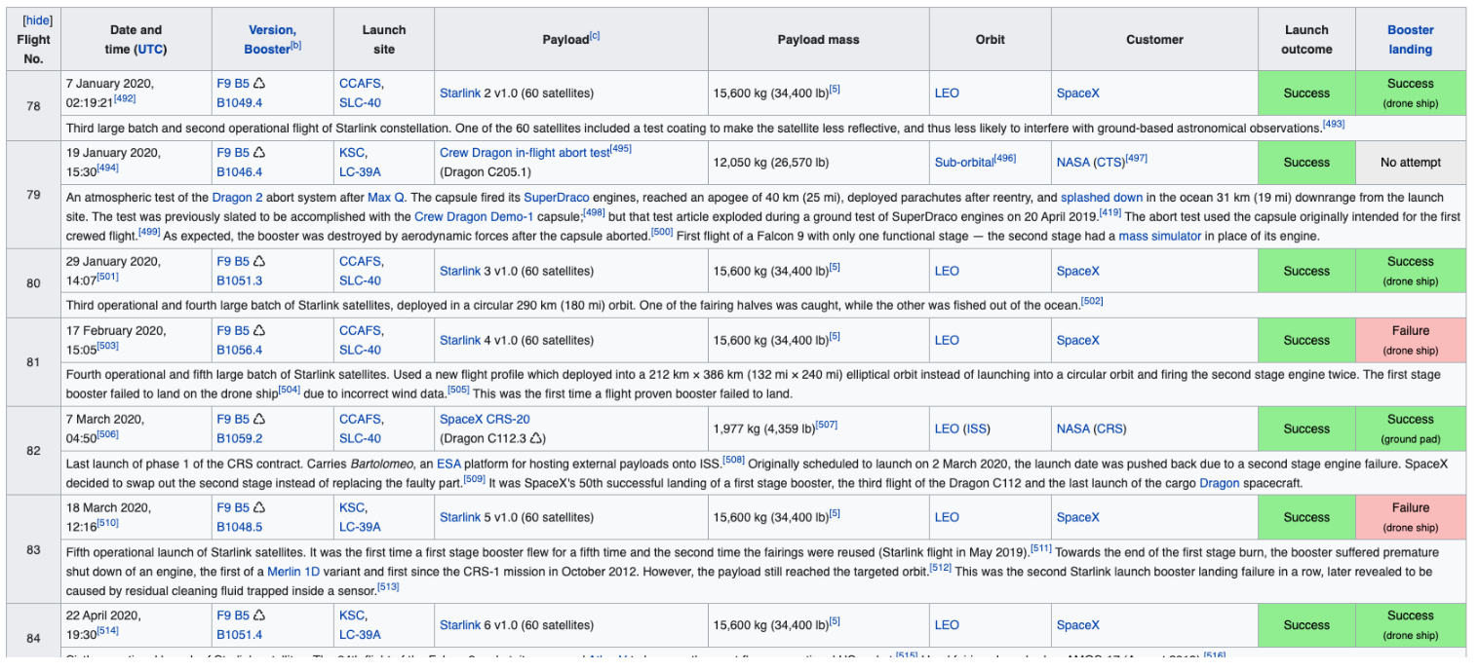
Data Collection - Scraping
GitHub URL of the completed web scraping notebook

Slide 10
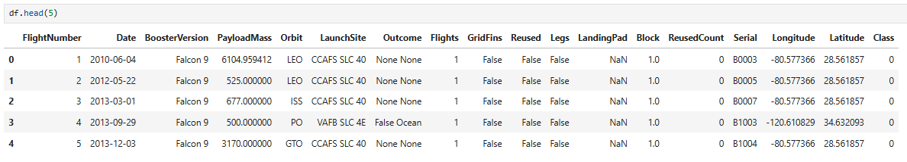
Data Wrangling
Calculate the number of launches on each site
Calculate the number and occurrence of each orbit
Calculate the number and occurence of mission outcome of the orbits
Create a landing outcome label
GitHub URL of your completed data wrangling related notebooks

Slide 11
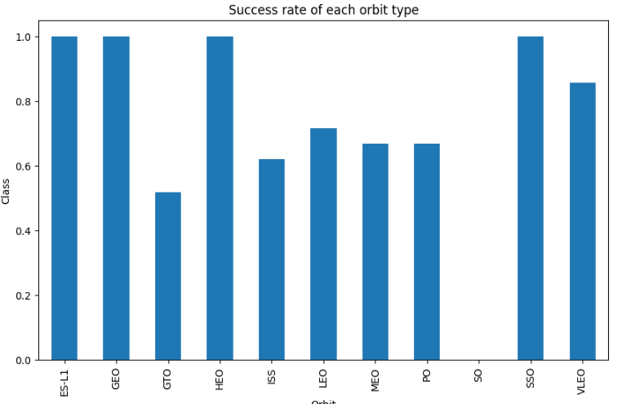
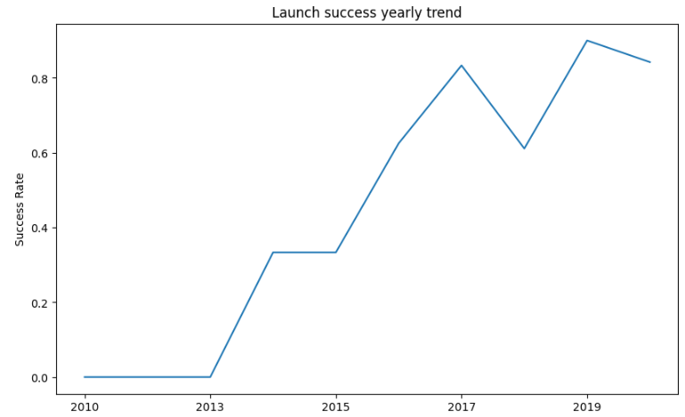
EDA with Data Visualization
The diagrams used are scatter plots, bar and line charts, showing the relationship between different variables and successful launches
GitHub URL of your completed EDA with data visualization notebook

Slide 12
EDA with SQL
These are the SQL queries performed:
Display the names of the unique launch sites in the space mission
Display 5 records where launch sites begin with the string 'CCA’
Display the total payload mass carried by boosters launched by NASA (CRS)
Display average payload mass carried by booster version F9 v1.1
List the date when the first succesful landing outcome in ground pad was achieved
List the names of the boosters which have success in drone ship and have payload mass greater than 4000 but less than 6000
List the total number of successful and failure mission outcomes
List the names of the booster_versions which have carried the maximum payload mass. Use a subquery
List the records which will display the month names, failure landing_outcomes in drone ship ,booster versions, launch_site for the months in year 2015
Rank the count of landing outcomes (such as Failure (drone ship) or Success (ground pad)) between the date 2010-06-04 and 2017-03-20, in descending order
GitHub URL of the completed EDA with SQL notebook

Slide 13
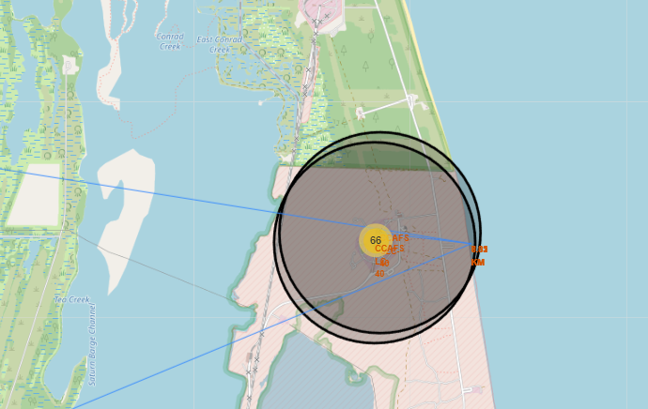
Build an Interactive Map with Folium
Circles, markers and lines have been added to the map in order to provide intuitive insights about where are the launch sites as well as distances to infrastructure
GitHub URL of the completed interactive map with Folium map

Slide 14
Build a Dashboard with Plotly Dash
Artefacts used are a pie chart, a scatter chart, the relation between successful launches and payload, selectable component for launch sites
The goal is to visually, and interactively, assess the relations between successful launches, payload and sites
GitHub URL of the completed Plotly Dash lab

Slide 15
Predictive Analysis (Classification)
After standardizing the data and splitting into training and test data sets, the following classification models have been assessed:
Logistic regression
Support vector machine
Decision tree
K nearest neighbors
For all the models, a confusion matrix has been created, and the accuracy on the test data has been calculated in order to find the best performing classification model
GitHub URL of the completed predictive analysis lab

Slide 16
Results
Exploratory data analysis results
Interactive analytics demo in screenshots
Predictive analysis results

Slide 17

Section 2

Slide 18
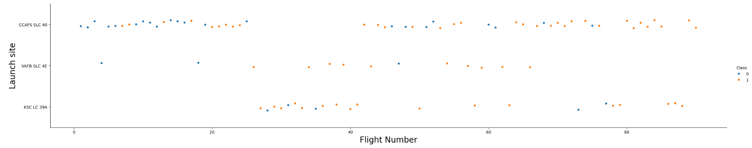
Flight Number vs. Launch Site
Scatter plot of Flight Number vs. Launch Site:
There is no connection between the flight number and the site, related to the success of a lunch

Slide 19
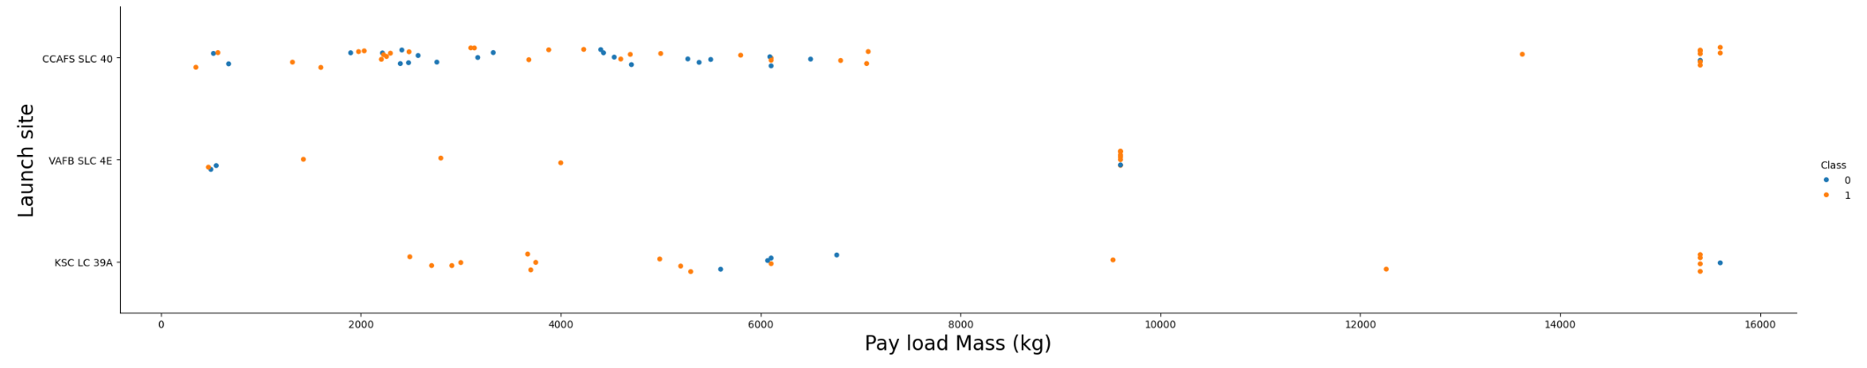
Payload vs. Launch Site
Scatter plot of Payload vs. Launch Site:
Lower payloads are more frequently launched from CCAFS SLC 40, and KSC LC 39A has a high ratio for successful launches for low payloads

Slide 20
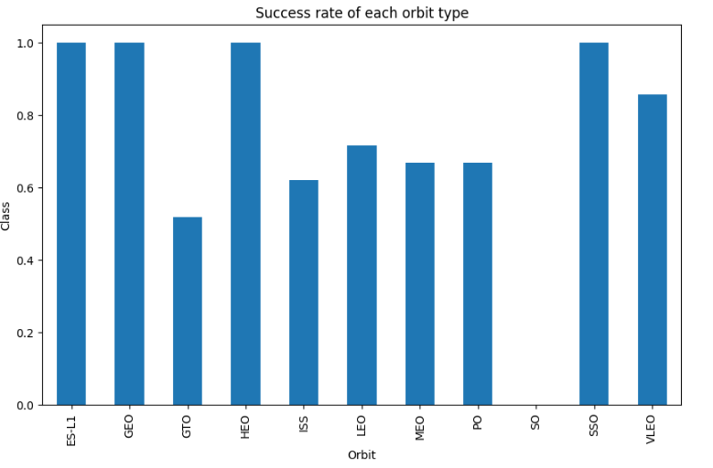
Success Rate vs. Orbit Type
Bar chart for the success rate of each orbit type:
Highest success rates are for orbits ES-L1, GEO, HEO, and SSO

Slide 21
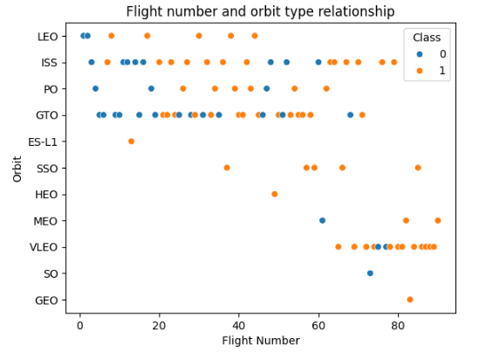
Flight Number vs. Orbit Type
Scatter plot of Flight number vs. Orbit type:
In the LEO orbit, success seems to be related to the number of flights

Slide 22
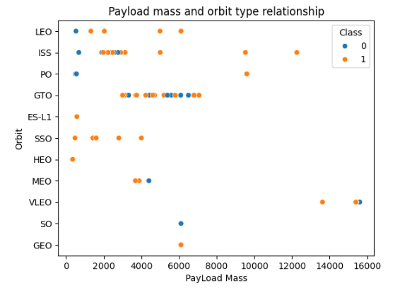
Payload vs. Orbit Type
Scatter plot of payload vs. orbit type:
With heavy payloads the successful landing rate is more for Polar,LEO and ISS

Slide 23
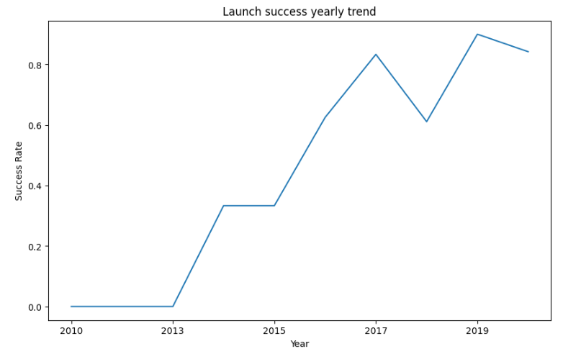
Launch Success Yearly Trend
Line chart of yearly average success rate:
The success rate since 2013 kept increasing till 2020

Slide 24
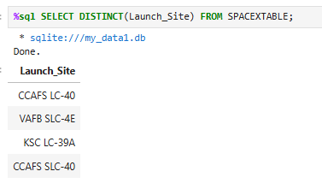
All Launch Site Names
Find the names of the unique launch sites:

Slide 25
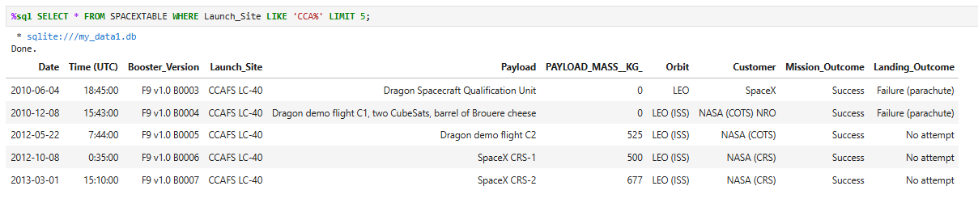
Launch Site Names Begin with 'CCA'
Find 5 records where launch sites begin with `CCA`:

Slide 26
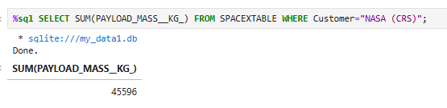
Total Payload Mass
Calculate the total payload carried by boosters from NASA:

Slide 27
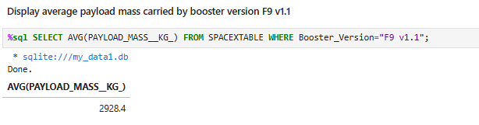
Average Payload Mass by F9 v1.1
Calculate the average payload mass carried by booster version F9 v1.1:

Slide 28
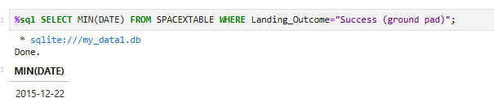
First Successful Ground Landing Date
Find the dates of the first successful landing outcome on ground pad:

Slide 29
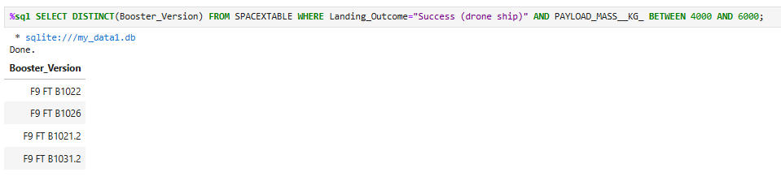
Successful Drone Ship Landing with Payload between 4000 and 6000
List the names of boosters which have successfully landed on drone ship and had payload mass greater than 4000 but less than 6000:

Slide 30
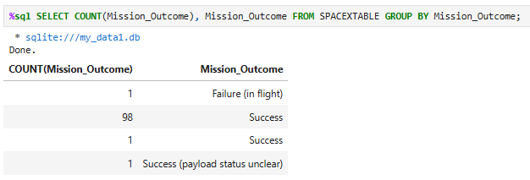
Total Number of Successful and Failure Mission Outcomes
Calculate the total number of successful and failure mission outcomes:

Slide 31
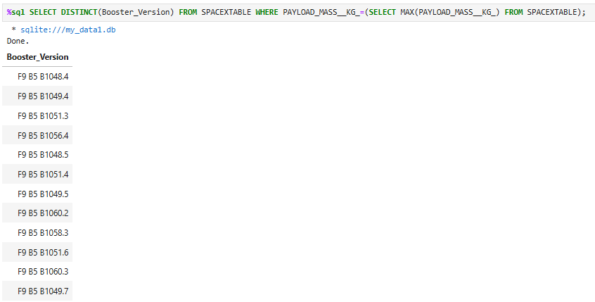
Boosters Carried Maximum Payload
List the names of the booster which have carried the maximum payload mass:

Slide 32
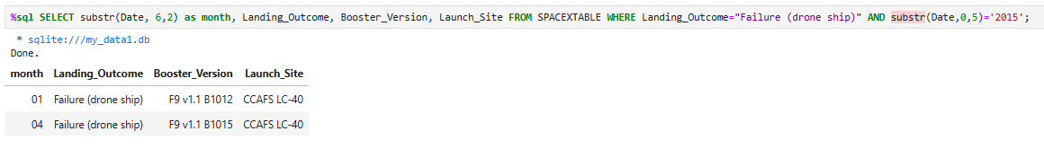
2015 Launch Records
List the failed landing_outcomes in drone ship, their booster versions, and launch site names for in year 2015:

Slide 33
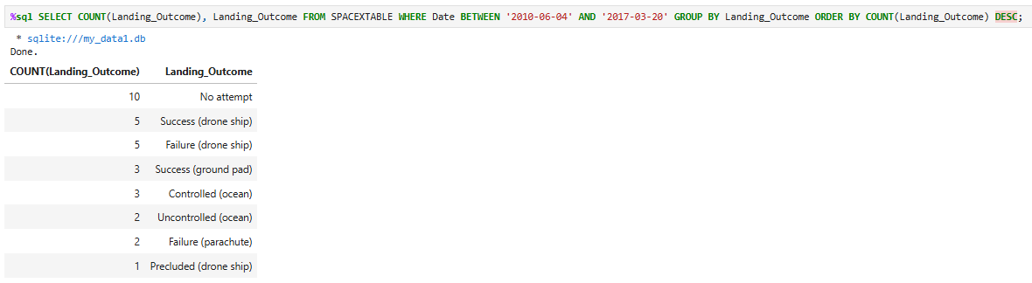
Rank Landing Outcomes Between 2010-06-04 and 2017-03-20
Rank the count of landing outcomes (such as Failure (drone ship) or Success (ground pad)) between the date 2010-06-04 and 2017-03-20, in descending order:

Slide 34

Section 3

Slide 35
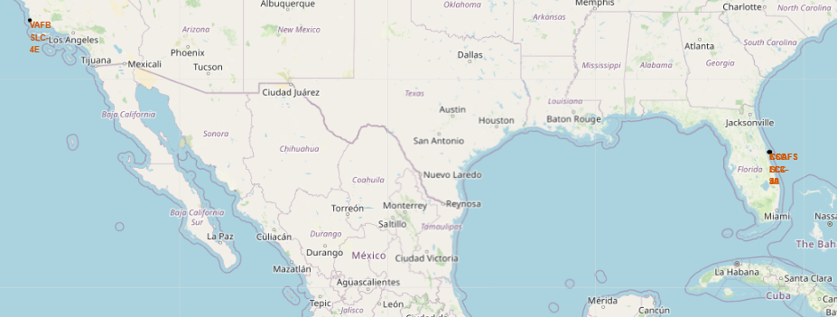
All launch sites
All launch sites are marked and labeled in the map

Slide 36
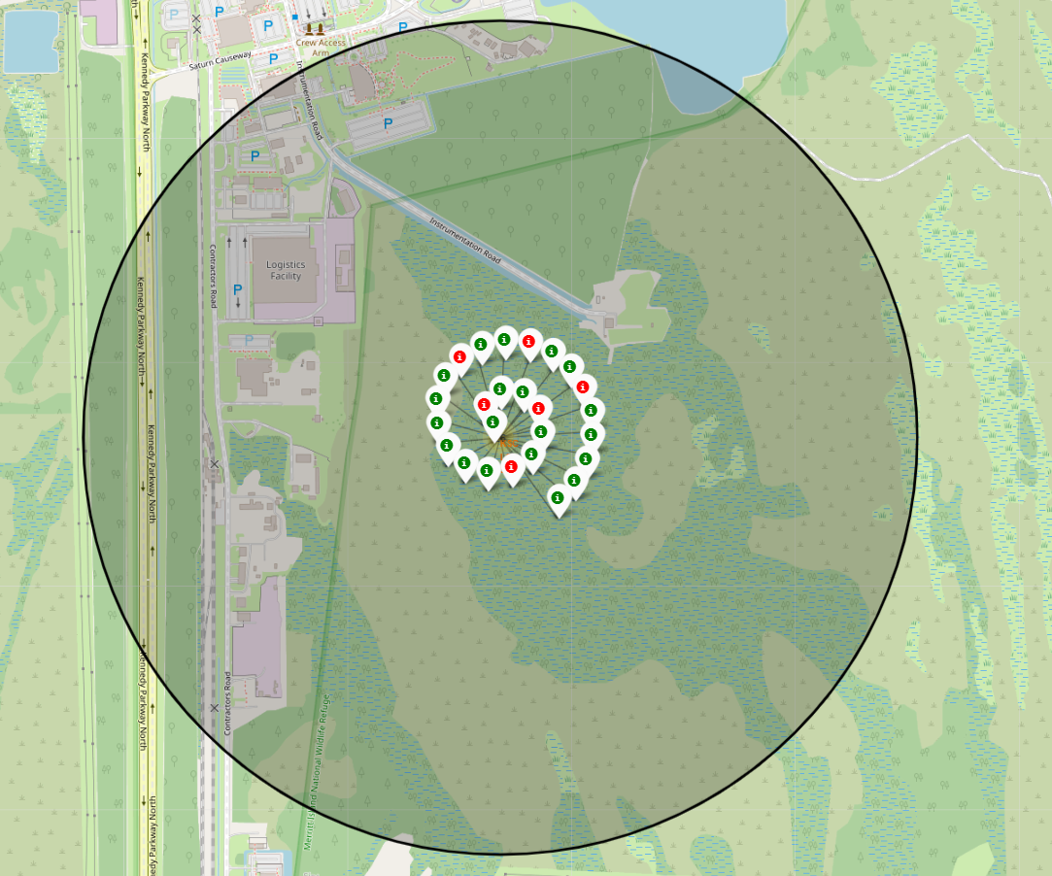
Launch outcomes
Color-labeled launch outcomes on the map, for a location

Slide 37
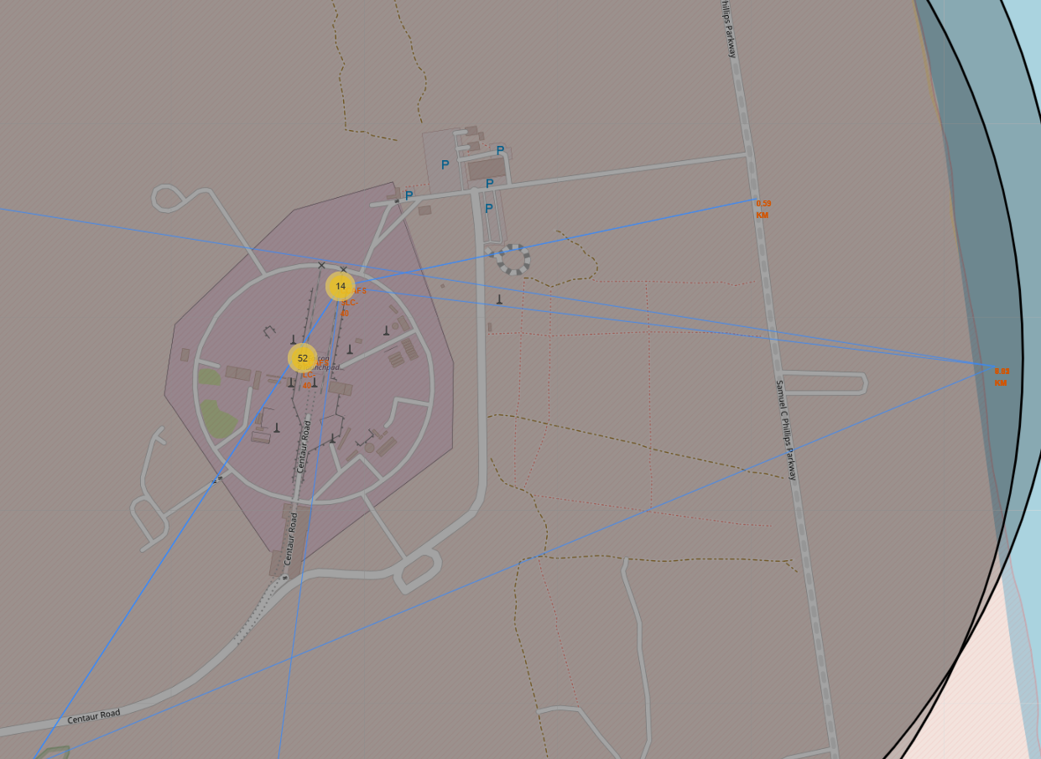
Distance to proximities
Screenshot of a selected launch site to its proximities such as railway, highway, coastline, with distance calculated and displayed:

Slide 38

Section 4

Slide 39
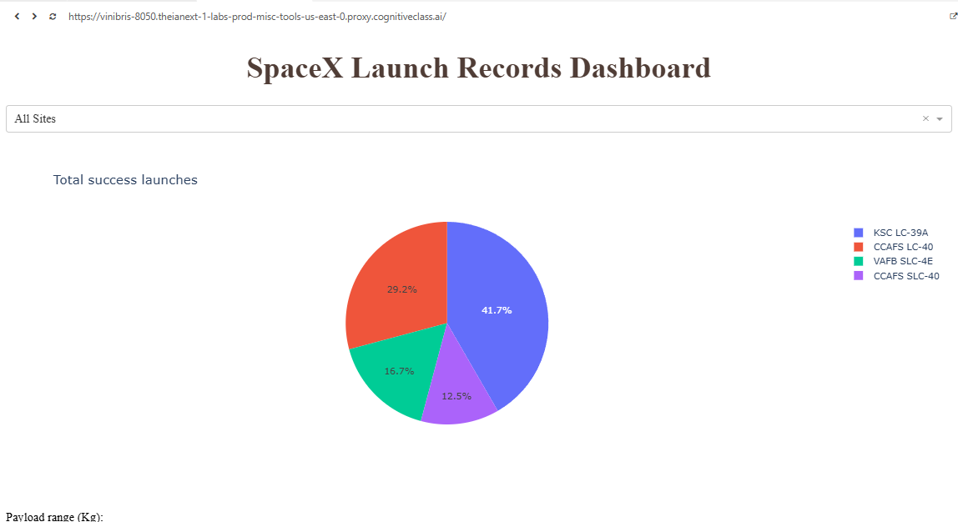
Launch success count for all sites
In the pie char, it can be seen that KSC LC-39A has the highest amount of success launches with 41.7%

Slide 40
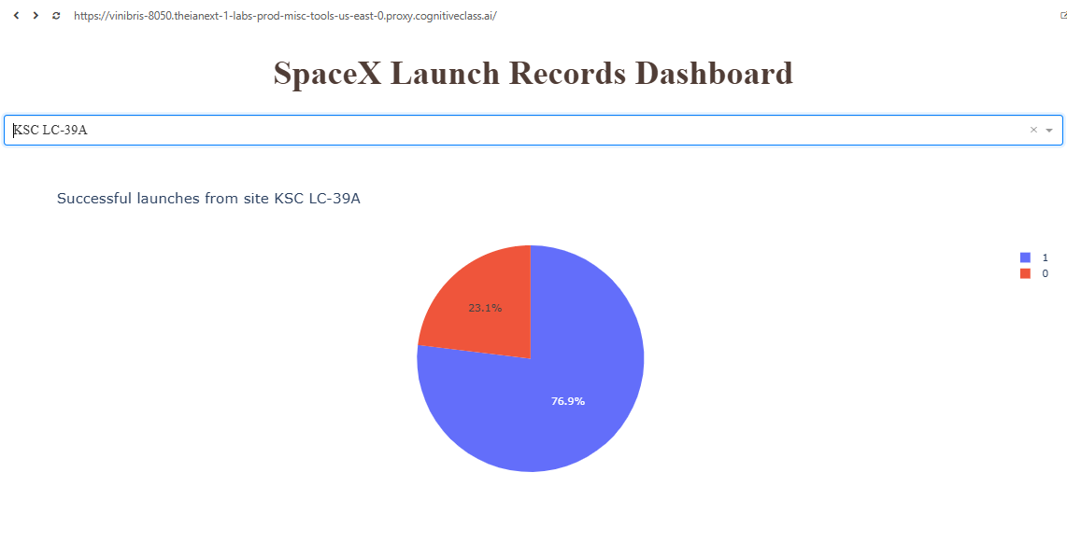
Launch site with highest launch success ratio
KSC LC-39A is the site with highest amount of success, with 76.9% success rate

Slide 41
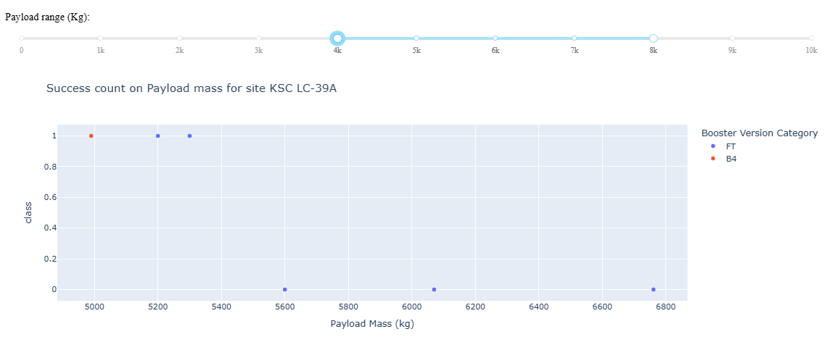
Payload vs. launch outcome (payload between 4000 and 8000)
Screenshot of Payload vs. Launch Outcome scatter plot for all sites, for a payload range between 4000 and 8000:
For that criteria, is mainly the booster FT performing, with a slightly higher number of failures than successes

Slide 42

Section 5

Slide 43
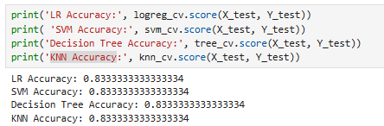
Classification Accuracy
Visualize the built model accuracy for all built classification models, in a bar chart
All models have the same classification accuracy

Slide 44
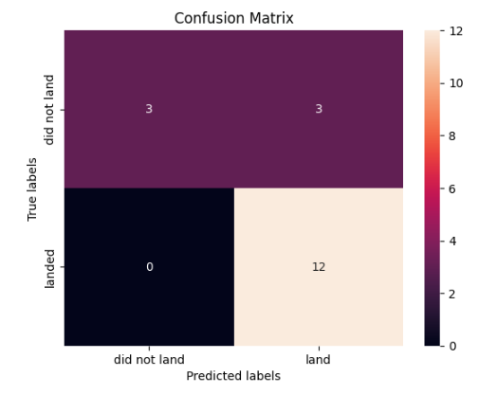
Confusion Matrix
12 launches are corrected labeled as landed

Slide 45
Conclusions
All models work well and with the same accuracy forecasting outcomes in this data
With time, the success rate for landing launches increases
Launch site 39A at Kennedy Space Center has the highest number of successful launches
GEO, HEO, SSO and ES L1 orbit types exhibit the highest rates of successful launches

Slide 46
Appendix

Slide 47


